Slide 1









LOGO
Quality Assurance for Reform and Transformation of HEIs in Uzbekistan - QUARTZ
Call: ERASMUS-EDU-2023-CBHE-STRAND-1 / Project Number: 101127171
Quality of Teaching and Student Services
Vanina Valcheva - Academic Affairs and Partnerships Manager
Varna University of Management
Janar Abuova
QUARTZ Training for Trainers
University of L’Aquila, 12 March 2025
"Funded by the European Union. Views and opinions expressed are however those of the author(s) only and do not necessarily reflect those of the European Union. Neither the European Union nor the granting authority can be."

Slide 2
LOGO
Outline
Supporting university growth
Stakeholders engagement
What is NQF?
Learning outcomes and ECTS
Student support and Learning
"Funded by the European Union. Views and opinions expressed are however those of the author(s) only and do not necessarily reflect those of the European Union. Neither the European Union nor the granting authority can be."

Slide 3

LOGO
The Best Higher Educational Institution
How do you see the best university?
Can you mention its features
"Funded by the European Union. Views and opinions expressed are however those of the author(s) only and do not necessarily reflect those of the European Union. Neither the European Union nor the granting authority can be."

Slide 4
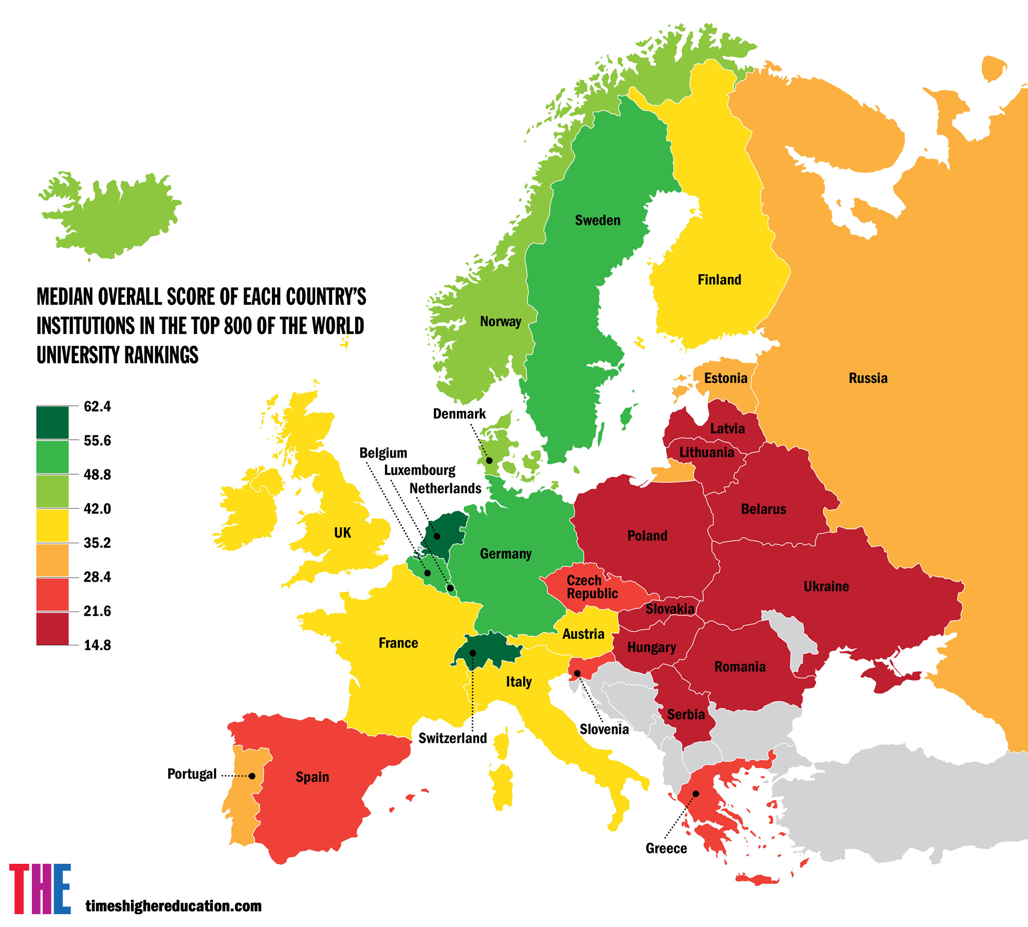

LOGO
How to achieve it?
"Funded by the European Union. Views and opinions expressed are however those of the author(s) only and do not necessarily reflect those of the European Union. Neither the European Union nor the granting authority can be."

Slide 5


Academic Offer Planning: Supporting Long-Term University Growth
Matching academic offerings with student and market needs & gaining efficiency and responsiveness in the short term
Identifying and Committing to Research Priorities to innovation and knowledge creation
Relevance, Competitiveness, Sustainability
Strategic positioning for sustainable success: evolving educational trends and industry demands
Maintain academic excellence to ensure quality assurance and accreditation compliance

Slide 6

Stakeholder Engagement: Incorporation and Measuring
Internal Stakeholders
Students
Faculty Members
University Governance
Non-Teaching Staff
External Stakeholders
Government Bodies and Accrediting Agencies
Employers and Industry Representatives
Alumni
Professional Bodies
Community

Slide 7

LOGO
Stakeholder engagement ?
"Funded by the European Union. Views and opinions expressed are however those of the author(s) only and do not necessarily reflect those of the European Union. Neither the European Union nor the granting authority can be."

Slide 8
LOGO
Asking right questions
It is important to know what kind of questions to ask from different stakeholders
Let’s try one activity
"Funded by the European Union. Views and opinions expressed are however those of the author(s) only and do not necessarily reflect those of the European Union. Neither the European Union nor the granting authority can be."

Slide 9
Asking the Right Questions: Students and Faculty
Students
How effectively are we gauging student satisfaction with our programme content, delivery and assessment methods?
What mechanisms do we have in place to encourage and facilitate meaningful student participation in feedback and decision-making processes?
How are we monitoring and addressing factors that influence student retention and successful programme completion?
Faculty Members
To what extent are our faculty members actively involved in curriculum design and programme review?
What opportunities and support do we provide for faculty professional development in areas such as curriculum design and innovative teaching methodologies?
How do we recognise and integrate faculty research and publications into programme content to foster innovation?

Slide 10
Asking the Right Questions: Administration and Non-teaching Staff
University Administration/Governance
How efficiently are we allocating resources to support robust programme development?
What policies have we implemented to promote and sustain collaborative programme development among stakeholders?
How regularly do we convene meetings with diverse stakeholders to discuss and advance programme initiatives?
Non-Teaching Staff
How do we assess and enhance the satisfaction levels of students and faculty with the support services provided by our administrative and support staff?
What training and development programmes are available to non-teaching staff to improve their contributions to programme support?
How do we evaluate and optimise operational processes to ensure seamless programme delivery?

Slide 11
Asking the Right Questions
Employers, Industry Representatives, and Professional Bodies
How can we integrate industry professionals into advisory boards to align curricula with evolving workforce demands? What strategies enhance employer collaboration in shaping graduate skills and attributes? How can we expand internships, placements, and industry-driven projects for students? Professional Recognition: How do we facilitate graduate access to necessary certifications and licences? How can we strengthen engagement with external stakeholders to support knowledge transfer, applied research and innovation?

Slide 12
Asking the Right Questions
Alumni
How engaged are alumni in providing feedback on programme relevance and quality? In what ways do alumni contribute, such as mentoring, guest lecturing, review committees, or financial support? How do we track and assess alumni career progression as an indicator of programme effectiveness?
What mechanisms do we have in place to foster a continuing sense of belonging among our alumni?

Slide 13
Asking the Right Questions
Community Engagement
How can academic programmes address real-world community challenges through applied research & innovation.
What initiatives can enhance the university’s role in societal development?
How can we integrate community-driven projects into learning experiences?
Lifelong learning & open access education: How do we extend learning opportunities to diverse community groups?
What mechanisms ensure continuous assessment and improvement of community engagement efforts?

Slide 14
LOGO
Purpose of Asking These Questions Across Stakeholders:
Students: Understand satisfaction, barriers, and aspirations.
Faculty: Ensure ownership in academic design and teaching innovation.
Support/Admin Staff: Enhance service quality and operational support.
Industry Professionals: Align outcomes with labor market needs.
Alumni: Gauge long-term relevance and gain champions for mentoring/funding.
Community: Address local challenges and enhance social impact.
"Funded by the European Union. Views and opinions expressed are however those of the author(s) only and do not necessarily reflect those of the European Union. Neither the European Union nor the granting authority can be."

Slide 15
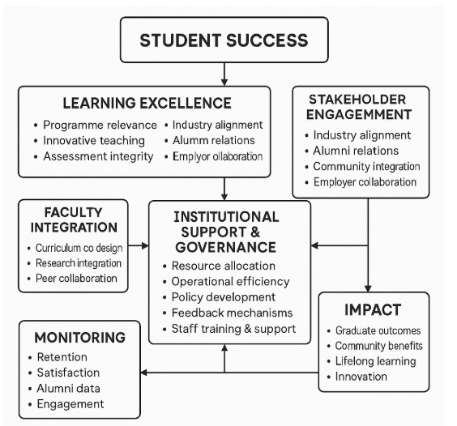
LOGO
It leads to students success
"Funded by the European Union. Views and opinions expressed are however those of the author(s) only and do not necessarily reflect those of the European Union. Neither the European Union nor the granting authority can be."

Slide 16

LOGO
Do you know what is National Qualification Framework?
"Funded by the European Union. Views and opinions expressed are however those of the author(s) only and do not necessarily reflect those of the European Union. Neither the European Union nor the granting authority can be."

Slide 17
NQFs – the European Context: Transparency, Comparability, and Portability
QF-EHEA Cycle | EQF Level | Description | Typical Qualifications
Short Cycle | Level 5 | Introductory higher education, bridging secondary education and bachelor's level. | Higher National Diplomas (HND), Foundation Degrees, Diplomas of Higher Education.
First Cycle | Level 6 | Undergraduate level, providing a broad knowledge base and developing analytical skills. | Bachelor's Degrees (e.g., BA, BSc), Professional Bachelor's Degrees.
Second Cycle | Level 7 | Postgraduate level, focusing on advanced study and original research. | Master's Degrees (e.g., MA, MSc), Integrated Master's Degrees.
Third Cycle | Level 8 | Doctoral level, involving substantial original research contributing new knowledge to the field. | Doctorates (e.g., PhD, DPhil), Professional Doctorates.
NQF of Uzbekistan available at:
Government of Uzbekistan. (2025). On measures to organize the activities of the National System for the Development of Professional Qualifications, Knowledge and Skills in the Republic of Uzbekistan. Lex.uz. Retrieved from https://lex.uz/en/docs/4814154

Slide 18
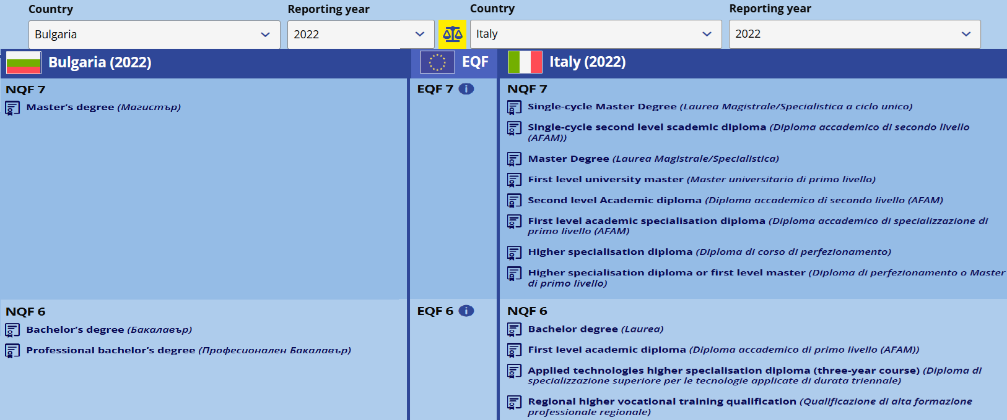
Comparable, still Unique
Source: CEDEFOP. (n.d.). National Qualifications Frameworks (NQF) Comparison Tool. Retrieved from https://www.cedefop.europa.eu/en/tools/nqfs-online-tool/nqf-comparison?country_1=BG&year_1=5340&country_2=IT&year_2=5340"

Slide 19

LOGO
How do we achieve our degree?
By earning credits and achieving learning outcomes
"Funded by the European Union. Views and opinions expressed are however those of the author(s) only and do not necessarily reflect those of the European Union. Neither the European Union nor the granting authority can be."

Slide 20
CORE PRINCIPLES AND ALIGNMENT MECHANISMS in HE
Learning Outcomes (LOs) are integral to the descriptors for each educational cycle (level) and define what learners are expected to know, understand, and be able to do after completing a learning process. The focus is on achieving specific knowledge, skills, and competencies.
Credit Accumulation and Transfer: The European Credit Transfer and Accumulation System (ECTS) is a tool to express the volume of learning based on the defined learning outcomes and their associated workload.

Slide 21
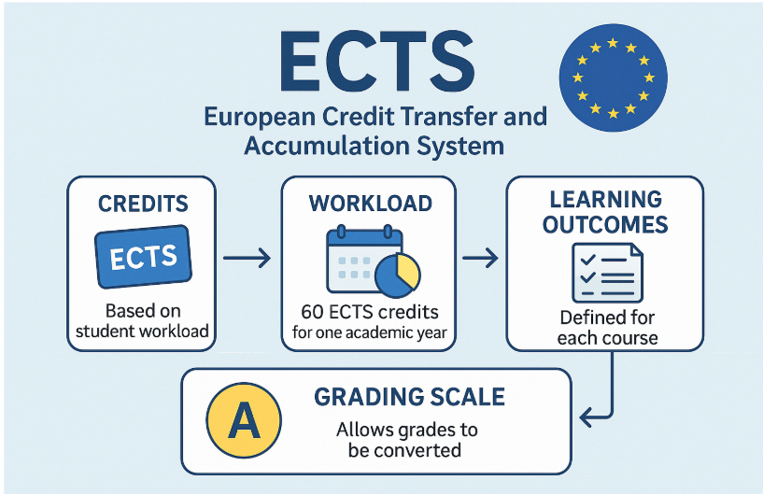
LOGO
"Funded by the European Union. Views and opinions expressed are however those of the author(s) only and do not necessarily reflect those of the European Union. Neither the European Union nor the granting authority can be."

Slide 22
Credit Accumulation and Transfer
Credit Accumulation and Allocation:
Learners earn credits by completing specific modules or units within a programme.
Each module/unit is assigned a credit value based on the estimated learning hours required for achieving the defined LOs, which encompasses all learning activities, including attending lectures, participating in seminars, independent study, and completing assignments.
Accumulated module credits contribute toward the total required for a qualification.
Credit Transfer:
Credits obtained from one institution or programme can be recognized and accepted by another.
Facilitates student mobility between institutions, both domestically and internationally.
Supports lifelong learning by acknowledging prior learning and experiences.
ECTS Allocation:
One credit corresponds to 25 to 30 hours of the total student's workload.
60 credits per full-time academic year
(please refer for further details to ECTS User’s Guide at https://ehea.info/media.ehea.info/file/ECTS_Guide/00/0/ects-users-guide-2015_614000.pdf)

Slide 23
LEARNING OUTCOMES – EQF (for Life-long Learning)
In the context of the EQF, the learning outcomes are defined in terms of:
Knowledge: described as theoretical and/or factual.
Skills: described as cognitive (involving the use of logical, intuitive and creative thinking) and practical (involving manual dexterity and the use of methods, materials, tools and instruments).
Responsibility and autonomy: described as the ability of the learner to apply knowledge and skills autonomously and with responsibility.

Slide 24
Recognition of Prior Learning (RPL)
Definition & Purpose
Evidence-based integration of previously acquired knowledge, skills, and experience into formal education.
“A formal acknowledgement by a competent authority of the value of a foreign educational qualification with a view to access to educational and/or employment activities.” (Lisbon Recognition Convention retrieved from https://ehea.info/media.ehea.info/file/Lisbon_Recognition_Convention/04/5/Lisbon_Recognition_Convention_579045.pdf)
Impact
Enhances Lifelong learning and career mobility.
Supports flexible educational pathways.
Promotes diversity and inclusivity in higher education.
Types
Formal – accredited education and qualifications.
Non-Formal – workplace training, professional certifications.
Informal – Self-directed learning, work/life experience.

Slide 25
LOGO
Program is ready.
What do we do next?
"Funded by the European Union. Views and opinions expressed are however those of the author(s) only and do not necessarily reflect those of the European Union. Neither the European Union nor the granting authority can be."

Slide 26

LOGO
Program is ready.
What do we do next?
What admission system do we need?
"Funded by the European Union. Views and opinions expressed are however those of the author(s) only and do not necessarily reflect those of the European Union. Neither the European Union nor the granting authority can be."

Slide 27
SSL: Admission - Fair & Transparent Access
Transparent Admission & Entry Policies
Admission criteria should be clear, publicly available, and consistently applied.
Equal access for all applicants to maintain fairness and institutional credibility.
Accommodation to diverse application needs, including support for international applicants, applicants with disabilities, transfer students, students applying with RPL.
Proper communication channels with applicants and prospective students

Slide 28
SSL: Student Induction & Orientation
Pre-Arrival Support (Before the Start of the Semester)
Welcome Week Activities (First Week of Semester)
Academic Orientation (First Week of Semester)
Student Wellbeing & Support (First Week of Semester)
Ongoing Induction Support (Throughout the First Semester)

Slide 29
SSL: Student Induction & Orientation
Pre-Arrival Support (Before the Start of the Semester)
Welcome Week Activities (First Week of Semester)
Academic Orientation (First Week of Semester)
Student Wellbeing & Support (First Week of Semester)
Ongoing Induction Support (Throughout the First Semester)
Access to online orientation materials (videos, handbooks, FAQs). Virtual Q&A sessions with faculty and student mentors. Completion of introductory academic skills modules. | University Introduction: Overview of mission, values, and academic culture. Campus & Facilities Tour: Library, IT services, student support centres, career offices. Meet Your Faculty: Introduction to department heads, tutors, and key academic staff. Social Integration: Ice-breaking activities, student clubs, networking events. | Understanding Programme Structure: Modules, credits, assessments, and progression pathways. Academic Integrity & Expectations: Plagiarism policies, research ethics, referencing guidelines. Learning Support Services: Study skills workshops, tutoring, language support. | Overview of counselling services. Guidance on financial aid, housing, and student welfare programmes. Safety briefing and emergency contact procedures. Student Career Services for internship and placements. Erasmus+ mobility opportunities. | Regular check-ins with academic advisors or personal tutors. Peer mentoring programmes for continued support. Mid-semester review session to address challenges and feedback.

Slide 30
SSL: Monitoring Student Progression
Institutions should implement robust mechanisms to monitor and support student progress.
Regular Monitoring and Reporting
Proactive Support Mechanisms
Institutional Interventions

Slide 31
SSL: Monitoring Student Progression
Institutions should implement robust mechanisms to monitor and support student progress.
Regular Monitoring and Reporting
Early Risk Identification: Weekly or monthly attendance tracking to detect at-risk students. Performance Reviews: Continuous academic evaluations (e.g., mid-term progress reports, formative assessments). Engagement Analytics: Tracking student participation in online platforms, discussion forums, and coursework.
Proactive Support Mechanisms
Advisory meetings: One-on-one or group mentoring sessions every month with academic advisors. Data-driven alerts: Systems that flag at-risk students (declining grades, low attendance, disengagement). Student feedback surveys: Regular check-ins on learning experience, workload, and support needs.
Institutional Interventions
Flexible learning pathways: Alternative routes for students requiring extra academic support. Faculty collaboration: Coordinated efforts between academic staff, student affairs, and career services to enhance support systems.

Slide 32
SSL: Facilitating Mobility & Recognition
Recognition of qualifications and learning periods is key to student mobility.
Ensures a coherent recognition in cooperation with national and international QA agencies (EU context ENIC/NARIC centres), and international partners.

Slide 33
ENIC-NARIC NETWORKS
ENIC (European Network of Information Centres)
NARIC (National Academic Recognition Information Centres in the EU)
What they do: https://www.enic-naric.net | Key Functions | Who can use ENIC/NARIC Services
Oversee and facilitate fair, consistent and transparent recognition of academic qualifications across countries | Recognition of Foreign Qualifications operating under the principles of the Lisbon Recognition Convention | Students seeking degree recognition abroad.
 | Support for Academic Mobility & Student Transfers | Universities evaluating international student applications.
 | Cooperation with Governments & Universities | Government agencies ensuring compliance with education agreements.
 |  | Employers verifying foreign academic credentials.

Slide 34
SSL: Certification & Graduation
Ensuring Qualification Transparency and Recognition Beyond Graduation
Upon graduation, students must receive clear, standardised documentation that verifies their qualifications:
The graduation documents should provide detailed information about the qualification, including:
Degree Award (Diploma)
Certificate of Completion
Diploma Supplement (DS)*
Learning outcomes achieved
Qualification level and academic content
Status of the awarded degree within the national and international education system (including referencing in DS to International Standard Classification of Education (ISCED)**
*Detailed information and a template for a European Diploma Supplement can be found on the EUROPASS website: https://europass.europa.eu/en/diploma-supplement-example-documents
**ISCED 2011 and ISCED Fields of Education and Training 2013 details also available at https://ec.europa.eu/eurostat/statistics-explained/index.php?title=International_Standard_Classification_of_Education_(ISCED)

Slide 35
SSL: Transparency of Regulations
HEIs should published their regulations pertinent to all phases of the Student Lifecycle:
on the University website
in the Programme Handbooks
Essential Information should include:
RPL Regulations
Student Support Services
Appeals, Complaints and Academic Regulations
Induction
Fees, scholarships, and student loans (if applicable)
Accommodation
Learning Centre Services
Student Representatives, Student Union, Student Charter
Progression and Transfer Opportunities
Health and Safety

Slide 36
LOGO
How can we build our dream university?
"Funded by the European Union. Views and opinions expressed are however those of the author(s) only and do not necessarily reflect those of the European Union. Neither the European Union nor the granting authority can be."

Slide 37
Sustaining Quality: Assurance and Continuous Improvement
Monitoring
Evidence
Review
Analysis
Report
Action plan

Slide 38
References
Anderson, L. W., Krathwohl, D. R., Airasian, P. W., Cruikshank, K. A., Mayer, R. E., Pintrich, P. R., Raths, J., & Wittrock, M. C. (2001). A taxonomy for learning, teaching, and assessing: A revision of Bloom's taxonomy of educational objectives. Longman. Retrieved from https://www.researchgate.net/publication/235465787_A_Taxonomy_for_Learning_Teaching_and_Assessing_A_Revision_of_Bloom's_Taxonomy_of_Educational_Objectives
Azusa Pacific University. (n.d.). Bloom’s taxonomy action verbs. Retrieved from https://www.apu.edu/live_data/files/333/blooms_taxonomy_action_verbs.pdf
Bologna Hub Peer Support II. (2025). Final conference. Retrieved from https://esu-online.org/projects/bhps-ii-bologna-hub-peer-support-ii/
Bologna With Student Eyes. (2020). Bologna with student eyes 2020. European Students' Union. Retrieved from https://www.esu-online.org/wp-content/uploads/2021/01/BWSE2020-Publication_WEB2.pdf
European Centre for the Development of Vocational Training. (2008). European university charter for lifelong learning adopted by EUA. https://www.cedefop.europa.eu/en/news/european-university-charter-lifelong-learning-adopted-eua
European Commission. (2022). Recognition of prior learning in Europe. Retrieved from https://education.ec.europa.eu/news/recognition-of-prior-learning-in-europe
European Commission. (n.d.). National qualifications framework (NQF) regulations. Retrieved from https://ec.europa.eu/programmes/erasmus-plus/project-result-content/af62df3c-7888-4f6d-8a92-370ed92c4658/General_Regulations_NQF_final_eng.pdf
European Higher Education Area (EHEA). (2009). Overarching framework for qualifications in the EHEA. Retrieved from https://ehea.info/cid102843/overarching-framework-qualifications-the-ehea-2009.html
European Higher Education Area (EHEA). (2015). ECTS Users’ Guide. Retrieved from https://ehea.info/media.ehea.info/file/ECTS_Guide/00/0/ects-users-guide-2015_614000.pdf
European Higher Education Area (EHEA). (2018). Standards and guidelines for quality assurance in the European Higher Education Area (ESG). Retrieved from https://www.ehea.info
European Higher Education Area (EHEA). (n.d.). Qualification frameworks in higher education. Retrieved from https://ehea.info/page-qualification-frameworks
European Network for Quality Assurance (ENQA). (n.d.). QA-FIT final paper. Retrieved from https://www.enqa.eu/wp-content/uploads/QA-FIT_Final-paper.pdf
European Network of Information Centres in the European Region (ENIC-NARIC). (n.d.). Recognition tools project. Retrieved from https://www.enic-naric.net/page-recognition-tools-projec
Erasmus+ Uzbekistan. (2025). Latest news in the system of higher education in Uzbekistan. Retrieved from https://www.erasmusplus.uz/Higher-education/Latest-news-in-the-system-of-higher-education-in-Uzbekistan/index.htm
Government of Uzbekistan. (2025). On measures to organize the activities of the National System for the Development of Professional Qualifications, Knowledge and Skills in the Republic of Uzbekistan. Lex.uz. Retrieved from https://lex.uz/en/docs/4814154
The Asia Today. (2025). Reforms in the higher education system of Uzbekistan aimed at preparing competitive personnel. Retrieved from https://theasiatoday.org/news/reforms-in-the-higher-education-system-of-uzbekistan-aimed-at-preparing-competitive-personnel/
UNESCO. (n.d.). Lifelong learning: What you need to know. Retrieved from https://www.unesco.org/en/lifelong-learning/need-know

Slide 39


LOGO
Thank you for your attention!
Quality Assurance for Reform and Transformation of HEIs in Uzbekistan - QUARTZ
Call: ERASMUS-EDU-2023-CBHE-STRAND-1
Project Number: 101127171

