Slide 1









LOGO
Quality Assurance for Reform and Transformation of HEIs in Uzbekistan - QUARTZ
Call: ERASMUS-EDU-2023-CBHE-STRAND-1 / Project Number: 101127171
Ensuring Quality in Higher Education: Programme Design, Student-Centred Learning, and Lifelong Learning Pathways
Vanina Valcheva - Academic Affairs and Partnerships Manager
Varna University of Management
QUARTZ Training for Trainers
University of L’Aquila, 12 March 2025
"Funded by the European Union. Views and opinions expressed are however those of the author(s) only and do not necessarily reflect those of the European Union. Neither the European Union nor the granting authority can be."

Slide 2
LOGO
Outline
ESG Standard 1.2: Design and approval of programmes (academic offer planning)
ESG Standard 1.3: Student-centred learning, teaching and assessment
ESG Standard 1.4: Student admission, progression, recognition and certification
Lifelong Learning
"Funded by the European Union. Views and opinions expressed are however those of the author(s) only and do not necessarily reflect those of the European Union. Neither the European Union nor the granting authority can be."

Slide 3


Academic Offer Planning: Supporting Long-Term University Growth
Matching academic offerings with student and market needs & gaining efficiency and responsiveness in the short term
Identifying and Committing to Research Priorities to innovation and knowledge creation
Relevance, Competitiveness, Sustainability
Strategic positioning for sustainable success: evolving educational trends and industry demands
Maintain academic excellence to ensure quality assurance and accreditation compliance

Slide 4

Academic Offer Planning: Supporting the Purposes of Higher Education
Preparation for the labour market – skills, competences, and adaptability
Preparation for life as active citizens in democratic societies – critical thinking, civic engagement, social responsibility, shared values
Personal development – soft skills, creativity, ethical decision-making, resilience, leadership
Development of a broad and advanced knowledge base – research, innovation, knowledge creation, interdisciplinary learning

Slide 5

Overview of Academic Offer Planning Approaches
Academic planning can follow a top-down, bottom-up, or hybrid approach.
Institutions choose a model based on governance structure, institutional priorities, and stakeholder involvement.

Slide 6
Top-Down Approach
Institutional leadership (President, Provost, Board of Trustees) sets broad strategic goals.
✅ Advantages:
Strong institutional alignment and strategic focus.
Efficient resource allocation and budgeting. Ensures compliance with accreditation and regulatory requirements.
❌ Challenges:
Risk of limited faculty and student engagement.
Less flexibility to respond to emerging academic needs.
Deans and department heads translate these priorities into specific and policies.
Academic units develop and implement programmes that align with the institution’s vision.

Slide 7
Bottom-Up Approach
Faculty and department chairs identify curriculum needs and research opportunities.
✅ Advantages:
Encourages faculty innovation and engagement.
More responsive to student needs and academic trends.
Enhances stakeholder participation in decision-making.
❌ Challenges:
Risk of fragmented programme development.
Inconsistent alignment with long-term institutional strategy.
Resource allocation challenges if departments operate independently.
Proposals are submitted to Deans and Institutional Leadership for review.
Leadership ensures alignment with institutional goals while providing resources and policy support.

Slide 8
Hybrid Approach (Blended Model)
Leadership sets broad academic priorities.
✅ Advantages:
Balances strategic oversight with academic innovation.
Ensures efficient resource management while maintaining academic flexibility.
Encourages collaborative decision-making and institutional coherence.
❌ Challenges:
Requires strong coordination and clear communication between all stakeholders.
Can be time-consuming due to the iterative feedback process.
Plans are finalised through an iterative feedback loop between administration and academic units.
Departments propose specific programmes, research agenda, and curricular innovations.
A collaborative review process aligns faculty-driven initiatives with institutional strategy.

Slide 9
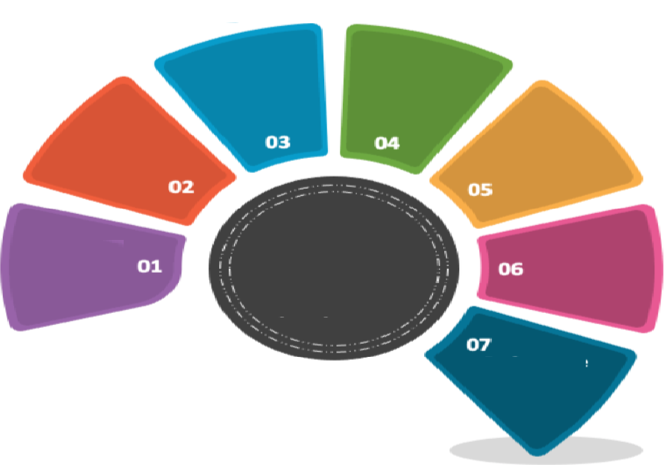
Resource Planning
Alignment with qualification frameworks
Alignment with Institutional Priorities
Ensuring Flexibility, Progression, Structured Student Lifecycle
Needs Assessment & Market Analysis
Stakeholder Engagement
Student-centred learning, teaching and assessment
QA Provisions
Programme (Portfolio) Design:
Key Components
Notes:
``

Slide 10

Stakeholder Engagement: Incorporation and Measuring
Internal Stakeholders
  Students
  Faculty Members
  University Governance
  Non-Teaching Staff
External Stakeholders
  Government Bodies and Accrediting Agencies
  Employers and Industry Representatives
  Alumni
  Professional Bodies
  Community

Slide 11
Asking the Right Questions: Students and Faculty
Students
  How effectively are we gauging student satisfaction with our programme content, delivery and assessment methods?
  What mechanisms do we have in place to encourage and facilitate meaningful student participation in feedback and decision-making processes?
  How are we monitoring and addressing factors that influence student retention and successful programme completion?
Faculty Members
  To what extent are our faculty members actively involved in curriculum design and programme review?
  What opportunities and support do we provide for faculty professional development in areas such as curriculum design and innovative teaching methodologies?
  How do we recognise and integrate faculty research and publications into programme content to foster innovation?

Slide 12
Asking the Right Questions: Administration and Non-teaching Staff
University Administration/Governance
  How efficiently are we allocating resources to support robust programme development?
  What policies have we implemented to promote and sustain collaborative programme development among stakeholders?
  How regularly do we convene meetings with diverse stakeholders to discuss and advance programme initiatives?
Non-Teaching Staff
  How do we assess and enhance the satisfaction levels of students and faculty with the support services provided by our administrative and support staff?
  What training and development programmes are available to non-teaching staff to improve their contributions to programme support?
  How do we evaluate and optimise operational processes to ensure seamless programme delivery?

Slide 13
Asking the Right Questions
Employers, Industry Representatives, and Professional Bodies
  How can we integrate industry professionals into advisory boards to align curricula with evolving workforce demands?
  What strategies enhance employer collaboration in shaping graduate skills and attributes?
  How can we expand internships, placements, and industry-driven projects for students?
  Professional Recognition: How do we facilitate graduate access to necessary certifications and licences?
  How can we strengthen engagement with external stakeholders to support knowledge transfer, applied research and innovation?

Slide 14
Asking the Right Questions
Alumni
  How engaged are alumni in providing feedback on programme relevance and quality?
  In what ways do alumni contribute, such as mentoring, guest lecturing, review committees, or financial support?
  How do we track and assess alumni career progression as an indicator of programme effectiveness?
  What mechanisms do we have in place to foster a continuing sense of belonging among our alumni?

Slide 15
Asking the Right Questions
Community Engagement
  How can academic programmes address real-world community challenges through applied research & innovation.
  What initiatives can enhance the university’s role in societal development?
  How can we integrate community-driven projects into learning experiences?
  Lifelong learning & open access education: How do we extend learning opportunities to diverse community groups?
  What mechanisms ensure continuous assessment and improvement of community engagement efforts?

Slide 16
Industry-Aligned Programme (Portfolio)
Labour market demand, competitor analysis, and student interest.
  Conduct market research and stakeholder consultations to assess industry demands and societal needs.
  Develop interdisciplinary and flexible programme structures that address emerging global challenges to keep pace with technological, economic, and academic advancements.
  Balance foundational modules with specialised and applied fields to create a diverse and adaptable portfolio, including placement opportunities.

Slide 17
Related Key Performance Indicators (KPIs)
Industry relevance of programmes (percentage of modules developed, monitored, and delivered with industry input)
Professionally accredited degrees (awards recognised by a relevant professional organisation)
Graduate employability rate (percentage of graduates employed within six months)
Number of partnerships with external stakeholders (industry, NGOs, government)
Credit-bearing placement modules, contributing to the qualification
Ratio of new programmes introduced vs. discontinued, percentage updated programmes (portfolio optimisation)
Enrolment trends per programme (growth rate and demand analysis).

Slide 18
Strategic Alignment and Institutional Resources
Alignment with University Strategy, Mission, and Vision
  National and regional priorities;
  Research, innovation, and societal impact;
  Inclusivity, excellence, and internationalisation.
Alignment with Institutional Resources
  Teaching, logistical, infrastructural, and research resources;
  Faculty expertise, laboratory facilities, and learning technologies;
  Sustainable resource allocation, including student services and campus infrastructure;
  Collaboration between academic and administrative units.

Slide 19
Related Key Performance Indicators (KPIs)
Percentage of programmes aligned with the university’s strategic goals (measured via curriculum mapping);
Number of interdisciplinary and research-driven programmes introduced;
Graduate impact assessment (employment rates, contributions to research, and societal engagement);
Stakeholder satisfaction levels (feedback from faculty, students, and industry partners);
Programme-to-resource ratio (ensuring infrastructure, faculty, and logistics match student demand);
Faculty-to-student ratio in each programme;
Utilisation rate of research and laboratory facilities per programme;
Percentage of programmes delivered with blended learning and digital tools;
Sustainability of programme offerings based on financial and logistical viability.

Slide 20
National Qualification Framework
The comprehensive system synchronising all qualifications within the education sector
at the national or sub-national level and specific to a country’s structure of education and training.
Outcome-Oriented
Prioritizes the achievements of learners over the educational processes undertaken.
Learning Outcomes
Specifies the knowledge, skills, and competencies a learner should possess upon earning a qualification.
Qualification Pathways
Illustrates how different qualifications interconnect, facilitating learner progression.
Diverse Learning Routes
Accommodates multiple educational pathways, including lifelong learning, leading to recognized qualifications.
Role in Education Development
Guides the structuring of degree systems and the design of academic programmes.
Recognition Facilitation and Stakeholder Relevance
Aids in the acknowledgment and understanding of qualifications by various stakeholders, e.g., learners and employers, in evaluating the value and applicability of qualifications.

Slide 21
NQFs – the European Context: Transparency, Comparability, and Portability
QF-EHEA Cycle | EQF Level | Description | Typical Qualifications
Short Cycle | Level 5 | Introductory higher education, bridging secondary education and bachelor's level. | Higher National Diplomas (HND), Foundation Degrees, Diplomas of Higher Education.
First Cycle | Level 6 | Undergraduate level, providing a broad knowledge base and developing analytical skills. | Bachelor's Degrees (e.g., BA, BSc), Professional Bachelor's Degrees.
Second Cycle | Level 7 | Postgraduate level, focusing on advanced study and original research. | Master's Degrees (e.g., MA, MSc), Integrated Master's Degrees.
Third Cycle | Level 8 | Doctoral level, involving substantial original research contributing new knowledge to the field. | Doctorates (e.g., PhD, DPhil), Professional Doctorates.
NQF of Uzbekistan available at:
Government of Uzbekistan. (2025). On measures to organize the activities of the National System for the Development of Professional Qualifications, Knowledge and Skills in the Republic of Uzbekistan. Lex.uz. Retrieved from https://lex.uz/en/docs/4814154

Slide 22
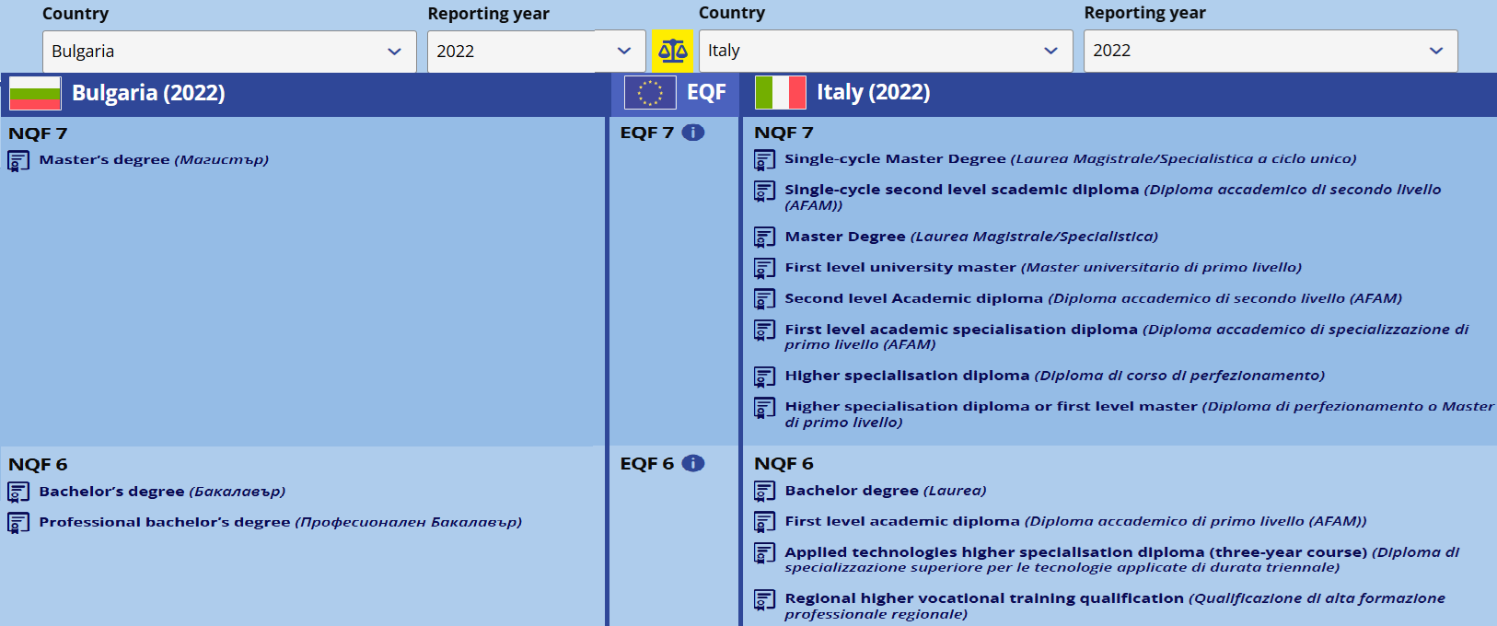
Comparable, still Unique
Source: CEDEFOP. (n.d.). National Qualifications Frameworks (NQF) Comparison Tool. Retrieved from https://www.cedefop.europa.eu/en/tools/nqfs-online-tool/nqf-comparison?country_1=BG&year_1=5340&country_2=IT&year_2=5340"

Slide 23
CORE PRINCIPLES AND ALIGNMENT MECHANISMS in HE
Learning Outcomes (LOs) are integral to the descriptors for each educational cycle (level) and define what learners are expected to know, understand, and be able to do after completing a learning process. The focus is on achieving specific knowledge, skills, and competencies.
Credit Accumulation and Transfer: The European Credit Transfer and Accumulation System (ECTS) is a tool to express the volume of learning based on the defined learning outcomes and their associated workload.

Slide 24
Credit Accumulation and Transfer
Credit Accumulation and Allocation:
Learners earn credits by completing specific modules or units within a programme.
Each module/unit is assigned a credit value based on the estimated learning hours required for achieving the defined LOs, which encompasses all learning activities, including attending lectures, participating in seminars, independent study, and completing assignments.
Accumulated module credits contribute toward the total required for a qualification.
Credit Transfer:
Credits obtained from one institution or programme can be recognized and accepted by another.
Facilitates student mobility between institutions, both domestically and internationally.
Supports lifelong learning by acknowledging prior learning and experiences.
ECTS Allocation:
One credit corresponds to 25 to 30 hours of the total student's workload.
60 credits per full-time academic year
(please refer for further details to ECTS User’s Guide at https://ehea.info/media.ehea.info/file/ECTS_Guide/00/0/ects-users-guide-2015_614000.pdf)

Slide 25
LEARNING OUTCOMES – EQF (for Life-long Learning)
In the context of the EQF, the learning outcomes are defined in terms of:
Knowledge: described as theoretical and/or factual.
Skills: described as cognitive (involving the use of logical, intuitive and creative thinking) and practical (involving manual dexterity and the use of methods, materials, tools and instruments).
Responsibility and autonomy: described as the ability of the learner to apply knowledge and skills autonomously and with responsibility.

Slide 26
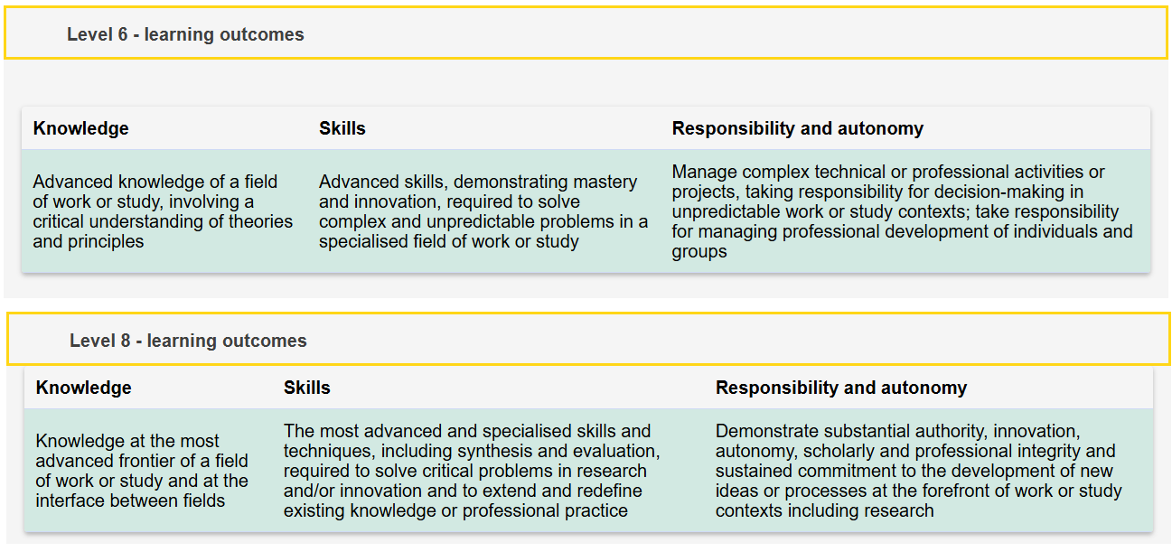
LEARNING OUTCOMES EQF - EXAMPLES
Source: European Union. (n.d.). Description of the eight EQF levels. Europass. Retrieved, from https://europass.europa.eu/en/description-eight-eqf-levels

Slide 27
LEARNING OUTCOMES – QF of EHEA
In the context of the QF - EHEA, the learning outcomes are defined in terms of:
Knowledge and Understanding: Depth and breadth of subject-specific knowledge.
Applying Knowledge and Understanding: Ability to utilize knowledge in practical contexts.
Making Judgments: Capacity for critical thinking and informed decision-making.
Communication Skills: Proficiency in conveying information effectively.
Learning Skills: Commitment to continuous learning and professional development.

Slide 28
Learning Outcomes of QF-EHEA - Example
Qualifications Framework for the European Higher Education Area (QF-EHEA)
 | Learning outcomes | ECTS credits
First cycle qualification | Qualifications that signify completion of the first cycle are awarded to students who: have demonstrated knowledge and understanding in a field of study that builds upon their general secondary education, and is typically at a level that, whilst supported by advanced textbooks, includes some aspects that will be informed by knowledge of the forefront of their field of study; can apply their knowledge and understanding in a manner that indicates a professional approach to their work or vocation, and have competences typically demonstrated through devising and sustaining arguments and solving problems within their field of study; have the ability to gather and interpret relevant data (usually within their field of study) to inform judgments that include reflection on relevant social, scientific or ethical issues; can communicate information, ideas, problems and solutions to both specialist and non-specialist audiences; have developed those learning skills that are necessary for them to continue to undertake further study with a high degree of autonomy. | Typically include 180- 240 ECTS credits
Source: European Higher Education Area (EHEA). (2018). Paris Communiqué: Appendix III. Retrieved from https://ehea.info/Upload/document/ministerial_declarations/EHEAParis2018_Communique_AppendixIII_952778.pdf

Slide 29
Programme LOs and Module LO: Ensuring Smooth Vertical Progression
Level-Appropriate Learning Outcomes: Each module should align with the qualification level at which it is taught.
Progressive Learning Approach: Modules build on each other to develop competencies over time.
Constructive Alignment: Teaching methods and assessments must match the cognitive demand of each level to accurately measure student attainment.
Prerequisites should be logical and reasonable, avoiding unnecessary repetition or barriers.

Slide 30
Example of LO Progression
L4: Describe key research methods used in business studies. (Understand, Apply)
L5: Compare and contrast qualitative and quantitative research approaches. (Analyse, Evaluate)
L6: Critically evaluate and apply research methodologies to an independent study. (Evaluate, Create)
Bloom’s Taxonomy & Learning Levels:
Cognitive Skills Progression: Learning outcomes move from lower-order thinking (Remember, Understand, Apply) to higher-order thinking (Analyse, Evaluate, Create).
More on the revised Bloom’s Taxonomy:
Anderson, L. W., Krathwohl, D. R., Airasian, P. W., Cruikshank, K. A., Mayer, R. E., Pintrich, P. R., Raths, J., & Wittrock, M. C. (2001). A taxonomy for learning, teaching, and assessing: A revision of Bloom's taxonomy of educational objectives. Longman. Retrieved from https://www.researchgate.net/publication/235465787_A_Taxonomy_for_Learning_Teaching_and_Assessing_A_Revision_of_Bloom's_Taxonomy_of_Educational_Objectives.
https://www.apu.edu/live_data/files/333/blooms_taxonomy_action_verbs.pdf

Slide 31
DEFINING LOs - Examples
Programme LOs – BSc Information Systems and Technologies at VUM
Module LOs – Computational Intelligence L6 | Module LOs – Principles of Programming L4
On successful completion of the module, students should be able to: Critically appraise a comprehensive/detailed understanding of the computational intelligence domain. Design and develop computational intelligence software artefacts. Critique and contextualise emerging research in the area of computational intelligence. | On successful completion of this module, students should be able to: Interpret software requirements from given scenario. Structure programs using key programming constructs. Identify and implement modular elements of programs. Demonstrate understanding of the key principles of user-centric design to design and develop appropriate user interfaces.

Slide 32
Ensuring LOs Alignment: Module LOs and Level LOs
Intended Programme Learning Outcomes to Core Level 4 Modules | Module A | Module B | Module C | Module D | Module E | Module F
LO 1 | Y |  | Y |  |  | Y
LO 2 | Y |  | Y | Y |  | Y
LO 3 | Y | Y | Y | Y | Y | Y
LO 4 | Y | Y |  | Y | Y
LO 5 |  | Y | Y | Y
LO 6 | Y |  | Y | Y | Y | Y
LO 7 | Y | Y |  | Y
LO 8 |  | Y | Y | Y |  | Y
LO 9 |  | Y | Y |  |  | Y
LO 10 |  | Y | Y |  | Y

Slide 33
Strengthening Programme Flexibility & Student Progression
Structuring a Balanced Curriculum
  Core, elective (optional), and facultative modules, as well as programme specialisations for structured yet flexible learning
Diversifying Learning Modes
  Full-time, part-time, blended, and to enhance accessibility
  Work-based learning to integrate professional experience into academic qualifications
Ensuring Seamless Recognition of Prior Learning and Credit Transfer
  Formal Leaning
  Non-formal Learning
  Informal Learning

Slide 34
Core, Elective, and Optional Components. Programme Pathways
Core Modules
  Essential for foundational and discipline-specific learning.
Electives (Optional Modules)
  Allow students to specialise in areas of interest.
Facultative Modules
  Support interdisciplinary learning and skill diversification (non-compulsory, supplementary learning, no direct impact on degree completion).
Programme Specialisations (Pathways)
  Allow students to choose a specialisation that aligns with career goals, e.g., MBA (Finance) or MBA (Sport Management), can be organised by pairing elective modules to lead to specialisation.

Slide 35
Multiple Study Modes for Accessibility and Inclusion
Full-time & Part-time
  Offers flexibility based on student needs and availability.
Blended & Online Learning
  Incorporates digital tools for hybrid education.
Work-Based Learning
  Internships, apprenticeships, that are incorporated as credit-bearing modules.

Slide 36
Recognition of Prior Learning (RPL)
Definition & Purpose
  Evidence-based integration of previously acquired knowledge, skills, and experience into formal education.
  “A formal acknowledgement by a competent authority of the value of a foreign educational qualification with a view to access to educational and/or employment activities.” (Lisbon Recognition Convention retrieved from https://ehea.info/media.ehea.info/file/Lisbon_Recognition_Convention/04/5/Lisbon_Recognition_Convention_579045.pdf)
Impact
  Enhances Lifelong learning and career mobility.
  Supports flexible educational pathways.
  Promotes diversity and inclusivity in higher education.
Types
  Formal – accredited education and qualifications.
  Non-Formal – workplace training, professional certifications.
  Informal – Self-directed learning, work/life experience.

Slide 37
Recognition of Prior Learning (RPL)
and Credit Transfer cont.
Recognition of Formal Learning
  Qualifications or periods of study for student transfer (advanced entry, credit exemption)
  Student mobility – Erasmus+ outgoing student mobility for studies or placement (including micro credentials), bilateral agreements between HEIs for Double or Joint Degree Programmes, University Alliances.
Recognition of Experiential Learning (RPEL)
  Prior learning gained through
    work, voluntary activities or other life experiences acquired outside of formal higher education or training systems.
    non-accredited training courses.
  Could be evidenced through work products (reports, minutes, emails etc.), testimonies, projects, professional publications, learning logs/reflective accounts, videos, audio.
  Involves an assessment process on the part of academic staff.

Slide 38
Recognition of Prior Learning (RPL)
and Credit Transfer: APPLICATION
Define Clear Parameters – Establish acceptable types, limits, and staff/faculty responsibilities for RPL credit transfer.
Integrate into Quality Assurance Systems (QA) – Embed RPL criteria and assessment methods within institutional QA frameworks, e.g., ECTS Guide, programme specifications, internal regulations and documentation for recognition.
Ensure Transparency – Make RPL policies publicly accessible for current and prospective students, including transfer and mobility students.

Slide 39
Programme Specification and Formal Approval
The approval and updating of the Programme specification should be integrated into the internal QA provisions.
Core elements of Programme Specification:
General Information
  Teaching/Awarding Institution
  Final Award and Programme Title
  Programme Director (Head of Department)
  Mode of Study, Normal Duration, and Period of Candidature, Language of study
  Subject Benchmark Statements, Professional Bodies Accreditations
  Date of Production

Slide 40
Programme Specification cont.
Admission criteria
Aims of the programme – broad and general, defining overall purpose
Qualification description – aligned with HEI strategic goals and NQF
Learning outcomes
Credits and award requirements
Programme structure and features, curriculum units (modules)
Teaching, learning and assessment methods
Module delivery and assessment timetable (generic)
Student commitments
Ethics and guidance on unfair practices in student work
Progression, employment and transfer opportunities
Academic support

Slide 41
Ensuring a Structured Student Lifecycle (SSL)
Institutions must apply consistent, transparent, and published regulations across all stages of the student journey, including cover admission, recognition of prior learning, academic progression, and final certification.
Why It Matters?
Supports student success and institutional integrity.
Ensures fair access, mobility, and qualification recognition across institutions and countries.
Aligns with international agreements (e.g., Lisbon Recognition Convention) for coherent recognition policies.

Slide 42
SSL: Admission - Fair & Transparent Access
Transparent Admission & Entry Policies
Admission criteria should be clear, publicly available, and consistently applied.
Equal access for all applicants to maintain fairness and institutional credibility.
Accommodation to diverse application needs, including support for international applicants, applicants with disabilities, transfer students, students applying with RPL.
Propper communication channels with applicants and prospective students

Slide 43
SSL: Student Induction & Orientation
Pre-Arrival Support (Before the Start of the Semester)
Welcome Week Activities (First Week of Semester)
Academic Orientation (First Week of Semester)
Student Wellbeing & Support (First Week of Semester)
Ongoing Induction Support (Throughout the First Semester)
Access to online orientation materials (videos, handbooks, FAQs). Virtual Q&A sessions with faculty and student mentors. Completion of introductory academic skills modules. | University Introduction: Overview of mission, values, and academic culture. Campus & Facilities Tour: Library, IT services, student support centres, career offices. Meet Your Faculty: Introduction to department heads, tutors, and key academic staff. Social Integration: Ice-breaking activities, student clubs, networking events. | Understanding Programme Structure: Modules, credits, assessments, and progression pathways. Academic Integrity & Expectations: Plagiarism policies, research ethics, referencing guidelines. Learning Support Services: Study skills workshops, tutoring, language support. | Overview of counselling services. Guidance on financial aid, housing, and student welfare programmes. Safety briefing and emergency contact procedures. Student Career Services for internship and placements. Erasmus+ mobility opportunities. | Regular check-ins with academic advisors or personal tutors. Peer mentoring programmes for continued support. Mid-semester review session to address challenges and feedback.

Slide 44
SSL: Monitoring Student Progression
Institutions should implement robust mechanisms to monitor and support student progress.
Regular Monitoring and Reporting
  Early Risk Identification: Weekly or monthly attendance tracking to detect at-risk students.
  Performance Reviews: Continuous academic evaluations (e.g., mid-term progress reports, formative assessments).
  Engagement Analytics: Tracking student participation in online platforms, discussion forums, and coursework.
Proactive Support Mechanisms
  Advisory meetings: One-on-one or group mentoring sessions every month with academic advisors.
  Data-driven alerts: Systems that flag at-risk students (declining grades, low attendance, disengagement).
  Student feedback surveys: Regular check-ins on learning experience, workload, and support needs.
Institutional Interventions
  Flexible learning pathways: Alternative routes for students requiring extra academic support.
  Faculty collaboration: Coordinated efforts between academic staff, student affairs, and career services to enhance support systems.

Slide 45
SSL: Facilitating Mobility & Recognition
Recognition of qualifications and learning periods is key to student mobility.
Ensures a coherent recognition in cooperation with national and international QA agencies (EU context ENIC/NARIC centres), and international partners.

Slide 46
ENIC-NARIC NETWORKS
ENIC (European Network of Information Centres)
NARIC (National Academic Recognition Information Centres in the EU)
What they do: https://www.enic-naric.net | Key Functions | Who can use ENIC/NARIC Services
Oversee and facilitate fair, consistent and transparent recognition of academic qualifications across countries | Recognition of Foreign Qualifications operating under the principles of the Lisbon Recognition Convention | Students seeking degree recognition abroad.
 | Support for Academic Mobility & Student Transfers | Universities evaluating international student applications.
 | Cooperation with Governments & Universities | Government agencies ensuring compliance with education agreements.
 |  | Employers verifying foreign academic credentials.

Slide 47
SSL: Certification & Graduation
Ensuring Qualification Transparency and Recognition Beyond Graduation
Upon graduation, students must receive clear, standardised documentation that verifies their qualifications:
The graduation documents should provide detailed information about the qualification, including:
  Degree Award (Diploma)
  Certificate of Completion
  Diploma Supplement (DS)*
  Learning outcomes achieved
  Qualification level and academic content
  Status of the awarded degree within the national and international education system (including referencing in DS to International Standard Classification of Education (ISCED)**
*Detailed information and a template for a European Diploma Supplement can be found on the EUROPASS website: https://europass.europa.eu/en/diploma-supplement-example-documents
**ISCED 2011 and ISCED Fields of Education and Training 2013 details also available at https://ec.europa.eu/eurostat/statistics-explained/index.php?title=International_Standard_Classification_of_Education_(ISCED)

Slide 48
SSL: Transparency of Regulations
HEIs should published their regulations pertinent to all phases of the Student Lifecycle:
  on the University website
  in the Programme Handbooks
Essential Information should include:
  RPL Regulations
  Student Support Services
  Appeals, Complaints and Academic Regulations
  Induction
  Fees, scholarships, and student loans (if applicable)
  Accommodation
  Learning Centre Services
  Student Representatives, Student Union, Student Charter
  Progression and Transfer Opportunities
  Health and Safety

Slide 49
Student-centred Learning, Teaching and Assessment
Fostering engagement, collaboration, and adaptability
Dictating knowledge transfer
Active Co-creators
Passive Recipients

Slide 50
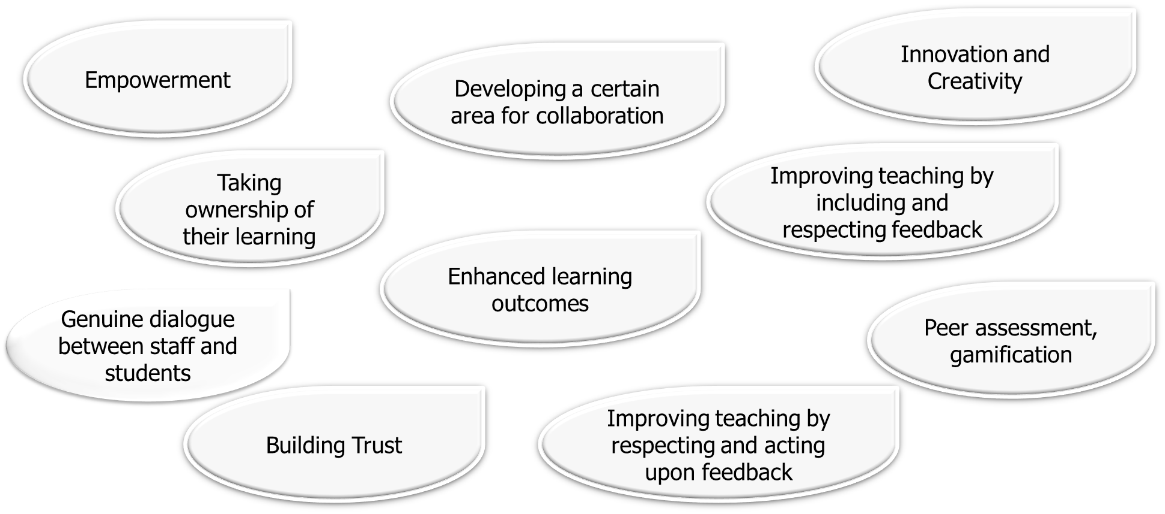
Student Involvement, Engagement, Partnership and Co-creation

Slide 51
Constructive Alignment. Outcome-centred Module Design
What are the specific learning outcomes students should achieve?
How can these outcomes be clearly communicated to students?
What are the core concepts and skills students need to learn?
What is the most logical sequence for presenting this content?
What assessment strategies will accurately measure student attainment of the outcomes?
How does the module align with accreditation and institutional requirements?
How can we ensure that all components work cohesively and sustainably to support student success?
Learning Outcomes
Outcome-centred Module Design
Assessment
Learning Activities

Slide 52
Expanding to a Student-centred Approach
What do students already know, and how does this shape their engagement?
How do students best learn, considering diverse backgrounds and different styles of learning?
What active learning strategies will deepen understanding?
How can assessments foster engagement and critical thinking?
How can students take ownership of their learning?
What opportunities allow students to apply knowledge in real-world contexts?
How can feedback enhance learning and reflection?

Slide 53
Student-centred Learning, Teaching and Assessment (SLTA): Key Principles
Flexibility & Inclusion
  Addresses diverse student needs with adaptable learning paths.
Varied Teaching Approaches
  Uses multiple delivery strategies and , including online, blended, and experiential learning.
Autonomy & Responsibility
  Encourages students to take charge of their own learning with teacher guidance.
Respect & Support
  Fosters a strong learner-teacher relationship.
Student Feedback for Continuous Improvement
  Regular opportunities for students to provide feedback on teaching methods, assessments, and module structure.

Slide 54
SLTA: Adaptable Learning Paths:
from foundational instruction to hands-on applications and self-directed learning.
Foundational Learning: Lectures & Directed Study
Interactive & Collaborative Learning
Practical & Applied Learning
Self-Paced & Digital Learning
  Formal Lectures: Provide a structured overview of core subject material, establishing a knowledge foundation.
  Virtual Learning Environments (VLEs): Platforms (e.g., Moodle) extend learning beyond the classroom with recorded lectures, resources, and supplementary materials.
  Directed Reading: Reinforces subject knowledge with curated academic resources.
  Tutorials: Clarify misconceptions, reinforce lecture content, and encourage peer discussions.
  Case Studies: Engage students in real-world problem-solving, requiring critical analysis and research.
  Problem-Based Learning (PBL): Encourages self-directed learning, teamwork, and practical application of knowledge.
  Seminars: Develop students' presentation, communication, and problem-solving skills through discussion-based learning.
  Practical Workshops: Offer hands-on experience, helping students refine their skills with structured academic support.
  Industry Experts & Guest Lectures: Bridge academic learning with real-world industry practices.
  Simulations & Lab Work: Provide experiential learning through virtual or in-person lab settings, technical exercises, and scenario-based applications.
  Fieldwork: Engages students in applying theoretical knowledge in authentic real-world settings.
  Online Discussion Forums & Digital Tools: Facilitate collaborative learning and peer interaction in a flexible, accessible format.
  Self-Paced Project-Based Learning: Encourages independent application of skills, allowing students to progress at their own pace while meeting structured milestones.

Slide 55
SLTA Example: Group Tasks
Purpose & Benefits | Strategies to Ensure Fair Participation
Enhances Collaboration: Encourages teamwork, communication, and problem-solving skills. Develops Critical Thinking: Promotes peer learning and diverse perspectives. Prepares for Real-World Challenges: Simulates workplace dynamics and cooperative projects. | Clear Roles & Responsibilities: Assign defined tasks to each member to ensure accountability. Regular Progress Check-Ins: Schedule meetings or instructor check-ins to monitor engagement. Weighted Contribution Grading: Allocate grades based on individual efforts alongside group outcomes. Use of Collaboration Tools: Encourage shared workspaces (e.g., Google Docs) for transparency. Peer & Self-Assessment: Implement peer evaluations or group reflective reports to track contributions and prevent freeriding.

Slide 56
SLTA Example: Flipped Teaching and Student-Led Workshops
Aspect | Flipped Teaching | Student-Led Workshops
Pre-Class Preparation | Students review materials before class | Students research and prepare materials for presentation
In-Class Role | Students apply knowledge through guided activities | Students take charge of teaching and discussion
Instructor’s Role | Facilitator, guiding discussions | Supportive mentor, providing feedback
Main Focus | Application and problem-solving | Leadership, facilitation, and knowledge sharing

Slide 57
SLTA Example: Peer-to-Peer Assessment
Peer assessment can be used as a structured evaluation method where students review and provide feedback on each other’s work based on predefined criteria.
Benefits:
For Students: Enhances critical thinking, self-reflection, and evaluative skills while promoting active engagement in learning.
For the Institution: Encourages student autonomy, collaborative learning, and accountability in coursework.
For Academic Development: Reinforces constructive feedback skills and prepares students for teamwork and evaluation processes in professional settings.

Slide 58
SLTA Example: Encouraging Cross-Cultural Understanding
Promotes cultural awareness and reduces stereotypes through collaborative learning.
Uses team-based projects, discussions, and case studies to explore cultural perspectives.
Encourages critical reflection and problem-solving in diverse contexts.
Example

Slide 59
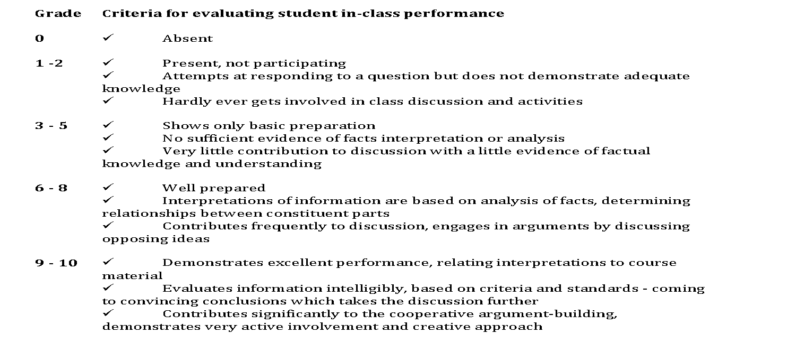
SLTA Example: Engaging In-Class Activities Assessment to Encourage Active Participation

Slide 60
SSLTA Example: Building Skills Through Small Tasks
  Helps students develop skills gradually.
  Encourages continuous learning and engagement.
  Provides both formative feedback and final assessment.
Why it Matters
  Portfolio Approach: Students complete small tasks that add up over time.
  Step-by-Step Learning: Each task builds on previous ones.
  Balanced Assessment: Mix of ongoing feedback and final evaluation.
How It Works
  Tracks progress effectively.
  Encourages reflection and deeper learning.
  Reduces stress from one-time exams.
Benefits

Slide 61
SSLTA: Ensure Consistent, Fair, Transparent, and Relevant Assessment
Key Principles
Fairness & Consistency: Assessments are applied equally to all students, following established procedures.
Transparency: Assessment criteria, marking schemes, and methods are published and explained in advance.
Relevance: Assessment aligns with module level, cognitive demand, and university marking criteria.
Quality Assurance: Ensures assessments support student progression and future careers.

Slide 62
SSLTA: Incorporate Diagnostic, Formative, and Summative Assessment
1. Diagnostic Assessment
  Purpose: Identifies prior knowledge, strengths, and areas for improvement.
  Examples: Pre-course quizzes, skills audits, self-assessments.
2. Formative Assessment
  Purpose: Provides feedback during learning to guide improvement.
  Examples: Draft submissions, peer reviews, in-class exercises.
3. Summative Assessment
  Purpose: Evaluates the achieved learning outcomes.
  Examples: Final exams and coursework, major projects, dissertations.

Slide 63
SSLTA: Best Practices for Effective Assessment
Clear & Aligned Criteria
  Assessment tasks should reflect learning outcomes and be appropriate for the level of study.
  Marking criteria must align with university and departmental standards.
Robust Quality Assurance
  Multiple Examiners: Where possible, assessments should be reviewed by more than one examiner.
  Training for Assessors: Faculty should receive support in developing fair and effective assessment methods.
  Consideration for Mitigating Circumstances: Policies should account for special student needs.
Transparent Feedback & Appeals Process
  Feedback: Regular, structured feedback linked to academic progress.
  Communication: How student requests and complaints have been actioned.
  Appeals Mechanism: A clear process for students to contest grades in a structured manner.

Slide 64
SSLTA: Ensuring Transparency – Making Assessment Information Available
Publishing Assessment Guidelines
  Provide students with clear assessment criteria and expectations.
  Share marking rubrics, deadlines, and weightings in advance.
Access to Feedback & Appeals
  Outline how students will receive feedback and opportunities for improvement.
  Ensure a structured grade appeal process is available.
Clear Communication Channels
  Use learning management systems to publish assessment details.
  Hold Q&A sessions to clarify expectations and procedures.

Slide 65
SSLTA: Monitoring and Enhancement
Key Evaluation Methods
Student Feedback: Collected through module evaluations, course rep discussions, and surveys.
Lecturer Self-Evaluation: Reflection on teaching effectiveness, student participation, and assessment strategies.
Performance Metrics: Analysing student performance data, attendance rates, and engagement levels.
Ongoing Curriculum Enhancement: Adjustments based on learning outcomes, student needs, and teaching innovations.
Example

Slide 66
Sustaining Quality: Assurance and Continuous Improvement
Monitoring
Evidence
Review
Analysis
Report
Action plan

Slide 67
Lifelong Learning (LLL) for All
Across All Age Groups
Spans an individual’s entire life, from early childhood to adulthood and beyond. Ensures learning opportunities tailored to different stages of life and career development.
Across All Education Levels
Creates connections between different education levels and pathways to include early education, primary and secondary schooling, higher education, adult education, and vocational training.
Across All Learning Modalities
Recognizes formal learning (structured education leading to qualifications), non-formal learning (alternative or supplementary learning opportunities), and informal learning (self-directed and experience-based learning).
Across All Learning Environments
Extends beyond schools to include homes, workplaces, communities, libraries, museums, and digital platforms, bridging formal education and non-formal/informal learning.
For a Variety of Purposes
Empowers individuals to reach their full potential and adapt to evolving societal and economic needs. Promotes lifelong personal, social, and professional growth while fostering inclusive and advanced societies.

Slide 68
What is Lifelong Learning?
Definition: Continuous, voluntary, and self-motivated pursuit of knowledge for personal or professional development.
Formal Learning: Structured, institution-based education (e.g., schools, universities, vocational training).
Non-Formal Learning: Organised learning outside traditional institutions (e.g., workplace training, workshops, MOOCs).
Informal Learning: Unstructured learning from daily activities (e.g., self-study, learning from experience, mentorship).
Examples:
  Online courses and certifications
  Apprenticeships and internships
  Volunteering and self-directed learning

Slide 69
LLL: Key Commitments of the HEIs
Embed Lifelong Learning as a Strategic Institutional Priority
Provide Inclusive and Flexible Learning Pathways
Recognise and Validate Prior Learning (RPL)
Enhance the Quality of Lifelong Learning Provision
Strengthen Partnerships with Employers and Society
Promote Interdisciplinary and Innovative Learning Approaches
Ensure Financial Support and Sustainability for Lifelong Learning
Support Professional Development of Academic Staff
Engage in National and International Policy Dialogue
Use Research and Data to Continuously Improve Lifelong Learning
European university charter for lifelong learning adopted by EUA. https://www.cedefop.europa.eu/en/news/european-university-charter-lifelong-learning-adopted-eua

Slide 70
LLL: Examples of HEIs Engagement
Flexible Learning Pathways | Micro-Credentials & Short Courses | Digital transformation - Blended & Online Learning | Collaborations with Industry & Society | Lifelong Learning Support Services
Stackable degrees -modular degree programmes that allow learners to accumulate smaller credentials over time, which can later be combined into a full degree. | Micro-credentials to certify the outcomes of small, tailored learning experiences to complement the current conventional learning opportunities. | MOOCs (Massive Open Online Courses) - freely available online educational resources that allow learners to access knowledge without financial or institutional barriers. | Work-based learning opportunities, internships and apprenticeships | Career counselling and upskilling programmes
Recognition of prior learning | Short courses for professional development certifications | Hybrid learning models | Recognition of prior experiential learning | Alumni continuing education opportunities
 | Customised corporate training | Self-paced learning platforms | Extending faculty expertise to vocational training, e.g., integrating VTC in University structures | Community engagement and public lectures

Slide 71
LLL: General Pitfalls
Limited Recognition: Informal and non-formal learning outcomes may not be widely recognised.
Access Barriers: High costs, digital divide, and lack of flexible learning opportunities.
Fragmented Systems: Weak connections between different education and training systems hinder smooth transitions.
Trust Issues: Employers and institutions may not fully trust non-traditional learning pathways.
Time Constraints: Balancing learning with work and personal responsibilities.

Slide 72
LLL: Future Development
Digital Transformation & Flexible Learning Pathways
  Increased use of online learning platforms and AI-driven education tools.
  Microcredentials and stackable degrees gaining acceptance.
Policy Innovations
  Strengthening national qualifications frameworks (NQFs) linked to European qualifications frameworks (EQF).
  Promotion of validation of non-formal and informal learning.
Stronger Integration
  Enhanced coherence between higher education, vocational training, and lifelong learning.
  Greater employer involvement in designing flexible learning pathways.
Support Mechanisms
  Financial aid for learners
  Workplace learning incentives
  Guidance and counselling services

Slide 73
References
Anderson, L. W., Krathwohl, D. R., Airasian, P. W., Cruikshank, K. A., Mayer, R. E., Pintrich, P. R., Raths, J., & Wittrock, M. C. (2001). A taxonomy for learning, teaching, and assessing: A revision of Bloom's taxonomy of educational objectives. Longman. Retrieved from https://www.researchgate.net/publication/235465787_A_Taxonomy_for_Learning_Teaching_and_Assessing_A_Revision_of_Bloom's_Taxonomy_of_Educational_Objectives
Azusa Pacific University. (n.d.). Bloom’s taxonomy action verbs. Retrieved from https://www.apu.edu/live_data/files/333/blooms_taxonomy_action_verbs.pdf
Bologna Hub Peer Support II. (2025). Final conference. Retrieved from https://esu-online.org/projects/bhps-ii-bologna-hub-peer-support-ii/
Bologna With Student Eyes. (2020). Bologna with student eyes 2020. European Students' Union. Retrieved from https://www.esu-online.org/wp-content/uploads/2021/01/BWSE2020-Publication_WEB2.pdf
European Centre for the Development of Vocational Training. (2008). European university charter for lifelong learning adopted by EUA. https://www.cedefop.europa.eu/en/news/european-university-charter-lifelong-learning-adopted-eua
European Commission. (2022). Recognition of prior learning in Europe. Retrieved from https://education.ec.europa.eu/news/recognition-of-prior-learning-in-europe
European Commission. (n.d.). National qualifications framework (NQF) regulations. Retrieved from https://ec.europa.eu/programmes/erasmus-plus/project-result-content/af62df3c-7888-4f6d-8a92-370ed92c4658/General_Regulations_NQF_final_eng.pdf
European Higher Education Area (EHEA). (2009). Overarching framework for qualifications in the EHEA. Retrieved from https://ehea.info/cid102843/overarching-framework-qualifications-the-ehea-2009.html
European Higher Education Area (EHEA). (2015). ECTS Users’ Guide. Retrieved from https://ehea.info/media.ehea.info/file/ECTS_Guide/00/0/ects-users-guide-2015_614000.pdf
European Higher Education Area (EHEA). (2018). Standards and guidelines for quality assurance in the European Higher Education Area (ESG). Retrieved from https://www.ehea.info
European Higher Education Area (EHEA). (n.d.). Qualification frameworks in higher education. Retrieved from https://ehea.info/page-qualification-frameworks
European Network for Quality Assurance (ENQA). (n.d.). QA-FIT final paper. Retrieved from https://www.enqa.eu/wp-content/uploads/QA-FIT_Final-paper.pdf
European Network of Information Centres in the European Region (ENIC-NARIC). (n.d.). Recognition tools project. Retrieved from https://www.enic-naric.net/page-recognition-tools-projec
Erasmus+ Uzbekistan. (2025). Latest news in the system of higher education in Uzbekistan. Retrieved from https://www.erasmusplus.uz/Higher-education/Latest-news-in-the-system-of-higher-education-in-Uzbekistan/index.htm
Government of Uzbekistan. (2025). On measures to organize the activities of the National System for the Development of Professional Qualifications, Knowledge and Skills in the Republic of Uzbekistan. Lex.uz. Retrieved from https://lex.uz/en/docs/4814154
The Asia Today. (2025). Reforms in the higher education system of Uzbekistan aimed at preparing competitive personnel. Retrieved from https://theasiatoday.org/news/reforms-in-the-higher-education-system-of-uzbekistan-aimed-at-preparing-competitive-personnel/
UNESCO. (n.d.). Lifelong learning: What you need to know. Retrieved from https://www.unesco.org/en/lifelong-learning/need-know

Slide 74


LOGO
Thank you for your attention!
Quality Assurance for Reform and Transformation of HEIs in Uzbekistan - QUARTZ
Call: ERASMUS-EDU-2023-CBHE-STRAND-1
Project Number: 101127171

